Slide 1
Introduction to medical oncology
Kamil Konopka MD

Slide 2
Introduction
Always ask
Have: white coat, stethoscopes, students' ID with you
Be on time
Try to pick up practical things
What is SAES?
What are „rotations”? And what are they for
Workshops?
PBL
Exam

Slide 3
Exercises
Department of medical oncology, Śniadeckich 10 str, 2nd floor
Meeting point : registration
Rotation

Slide 4
SAES
The topics of these presentations should be chosen by students
from the available list :
1. Bowel obstruction in cancer patients
2. VTE and cancer
3. Oncoemergency: increased intracranial pressure
4. Pericardial tamponade due to malignant pericardial effusion
Students are asked to divide into 4 equal groups (per each SAES meeting) and prepare ppt. The time is 7-10 minutes for presentation plus 1-2 minutes for discussion/questions, which means no more than 12 slides (including ‘hello’ and ‘thank you’slide;
Not only the presentation itself, but also the way it is presented are taken into consideration.

Slide 5
Workshops
Chemotherapy related diarrhea
Nephrotoxicity and bladder injury
Chemotherapy induced nausea and vomiting
Dermato-toxicity (Acne-like rash and secondary skin malignancy in cancer treatment)
Immune-related adverse reaction

Slide 6
Radiotherapy
Prokocim, Wielicka str. (University Children’s Hospital of Cracow )
Sala pod witrażem
Lecture room under stained-glass

Slide 7
Exam
Last day of course
50 single answer questions.
Cowered in presentations

Slide 8
Principles of oncology

Slide 9
Principles
Oncologist – a simple person
3 questions rule
1. Is it a cancer?
2. What type of cancer (WHERE is primary)?
3. What is the intention of treatment?
When to stop/ why not to start the treatment?

Slide 10
Type
Adenocarcioma
Squamous cell carcinoma
Sarcoma
Lymphoma and leukemia
etc

Slide 13
Histopathology
Type of cancer define type of treatment
Adenocarcinoma of esophagus ≠ Squamous cell cancer of esophagus
Subtype not that important
A bit obsolete

Slide 15
Staging
Tumor
Local invasion
Adjacent tissue
Nodes
Metastases
TNM staging system
How big is it?

Slide 16
TNM
T(umor)
Size, depth of invasion etc
N(odes)
Only local/regional
Number, size, localization
M(etastases)
Single, multiple

Slide 17
Grade
Grade I
Grade II
Grade III
Grade IV
How aggressive it is?
A bit obsolete, but still important

Slide 19
Cancer
What is our intention?
Curative
Palliative
Our methods?
Our aggressiveness?

Slide 20
Curative
Localized solid tumors
Oligometastases
Extremely chemosensitive tumors
Testicular cancer
Some lymphomas and leukemia's

Slide 21
Palliative
Stage IV solid tumors
When radical treatment of metastases is not feasible
Locally advanced tumors
When radical treatment is not possible
Patient in poor general condition not feasible for curative treatment

Slide 22
Cancer
Palliative ≠ Palliative
Palliative chemotherapy in colon cancer stage IV
OS from 6 months to 2-3 years
Palliative care = hospice care

Slide 23
Cancer

Slide 24
Principles
Explain the principles of treatment over your patient on every level of disease
Evaluate the prognostic factors: tumor’s location, staging, grading, failure of primary treatment, length of time from the treatment to relapse, PS, nutrition
Individualize plan of treatment
Treat the patient not only the disease: coping with physical symptoms; identification of situations when secondary, negative effects are stronger; psychological support
Radical and palliative treatment

Slide 25
Principles
Patients treated at the comprehensive cancer center have considerably better survival than those treated in a local hospital! (Harding et al, 1993, Junior et al, 1994, Gillis et al, 1996)

Slide 26
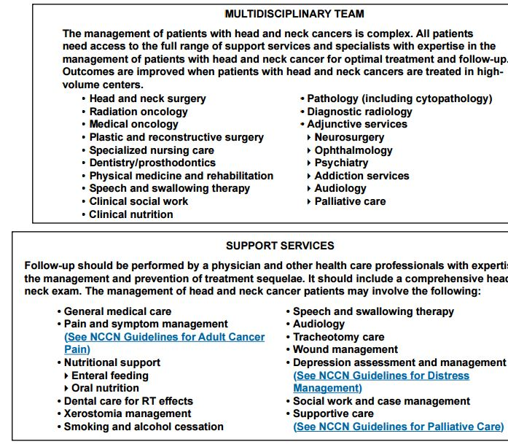
Multidiscilinary team

Slide 27
Oncology
Surgical oncology
Radiation oncology
Medical oncology

Slide 28
Medical oncology
Not an „universal” speciality
Medical oncology (drugs, PL, UK, FRA)
Clinical oncology (drugs + radiotherapy, UK)
Hematooncology (cancer + leukemia, Ger)
Surgical oncology, gynecological oncology (drugs + surgery, PL)

Slide 29
Modalities
Knife
Beam
Drug
Goal?
Eradicate all cancer cells
Do not kill patients

Slide 30
Modalities
Are all methods of treatment equal?
Surgery> Radiotherapy> Systemic treatment

Slide 31
Drugs
Chemotherapy
Hormonotherapy
Targeted treatment
Immunotherapy
TKI inhibitors
Monoclonal antibodies
etc

Slide 32
Subjective efficacy index
Authors own reflection
Not a true index
Do not use it outside of this presentation☺
Antibiotics = 10/10

Slide 33
Cytotoxic chemotherapy
Old
Cheap
Toxic
„Spearhead” treatment
Subjective efficacy index =5/10
….. Probably will not evolve too much….
Still a cornerstone

Slide 34
Hormonotherapy
Old
Cheap
Safe
„weapon only effective against special types of enemies”
SIE 8/10
…only effective in small group of diseases…
…probably will not evolve to much…

Slide 35
Targeted treatment
Modern
Expensive
100k $ for ipilimumab
10k $/month for vemurafenb
„Sniper gun”
SEI 6/10
…probably will evlove…
…but not yet evolved…

Slide 36
Chemotherapy
Curative
Testicular cancer, lymphomas
Neoadjuvant, adjuvant, concurrent
To enhance efficacy, shrink tumor, decrease risk of recurrence
Palliative
To increase survival
To maintain QoL
To decrease symptoms of disease

Slide 37
Chemotherapy
Is treatment successful
RECIST (Response evaluation criteria in solid tumors)
CR – complete response
PR – partial response (>30%)
SD- stable disease
PD – progressive disease

Slide 38
DNR
Do not resuscitate
No such law in Poland
„Persistant therapy”

Slide 39
Tumor markers
Less useful than you may think
Screening of healthy population – false/true
Diagnosis of a malignancy – false
Determining the prognosis – true
Monitoring of patient during/ after treatment - true

Slide 40
Tumor markers
Germinal tumors B-HCG , AFP, LDH
Colon cancer > CEA , Ca 19-9
Prostate ca > PSA
Medullary thyroid cancer > calcitonin
Ovarian cancer > Ca 125, HE4
Pancreatic cancer > Ca 19-9
Gastric cancer > Ca 19-9, CEA
Hepatocellular cancer > AFP
Breast ca > Ca 15.3

Slide 41
Definitions
Prognostic factor
Predictive factor

Slide 42
Definitions
Factors
Prognostic factor tells us about disease
Predictive factor tells us about treatment

Slide 43
Definitions
OS (overall survival)
Time from diagnosis to death
PFS (progression free survival)
Time from initiation of treatment to progression or death
1y, 3y, 5y-survival
RR (response rate)
RECIST PR+CR
CTC AE (common toxicity criteria of adverse events)

Slide 44
CTC AE

Slide 45
CTC AE
G1, G2 – mild
G3, G4 – severe
G5 - fatal

Slide 46
PS (Zubrod scale)
PS0 – asymptomatic
PS1 – symptomatic, but in good condition
PS2 -<50% daytime in bed
PS3 ->50 of daytime in bed
PS4 – bedbound
PS5- dead

Slide 47
Guidelines
NCCN
ESMO
PUO

Slide 48
NCCN

Slide 49
NCCN

Slide 51
Thank you for your time

